Slide 1

AFFLUENCE FASHION LIMITED. IS ONE OF THELEADING FASHION BUYING HOUSE IN BANGLADESH.

Slide 2
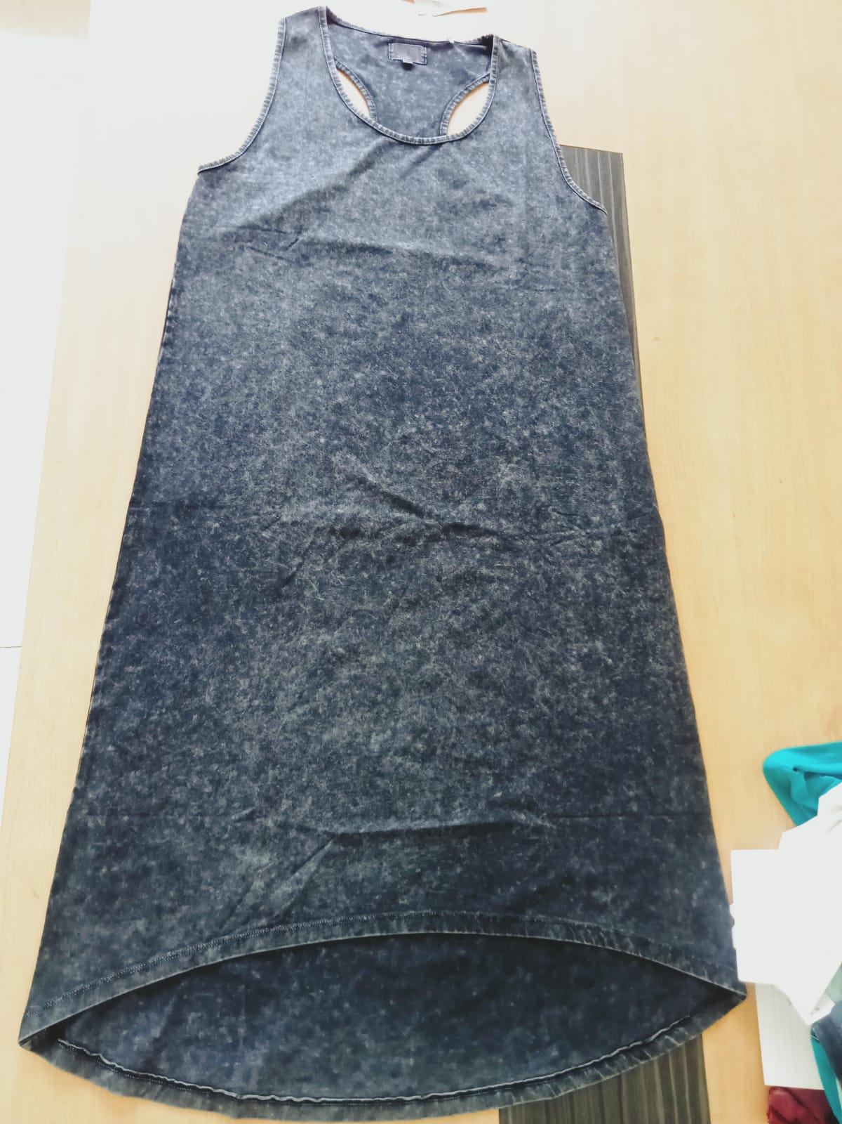
Ladies
Style # LAFGO
Fabric : 95% cotton, 5 % elastane 220gsm, Single jersay, acid wash
MOQ – 3000 pcs , Price - $ 5. 13

Slide 3
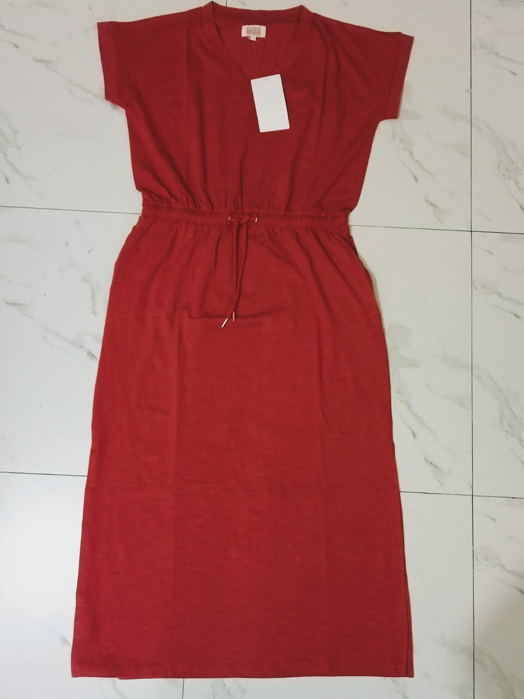
Ladies
Style # RIUS
Fabric : 95% Cotton, 5% Elastan 180gsm, slub+garment wash
MOQ – 3000 pcs , Price - $ 5. 10

Slide 4
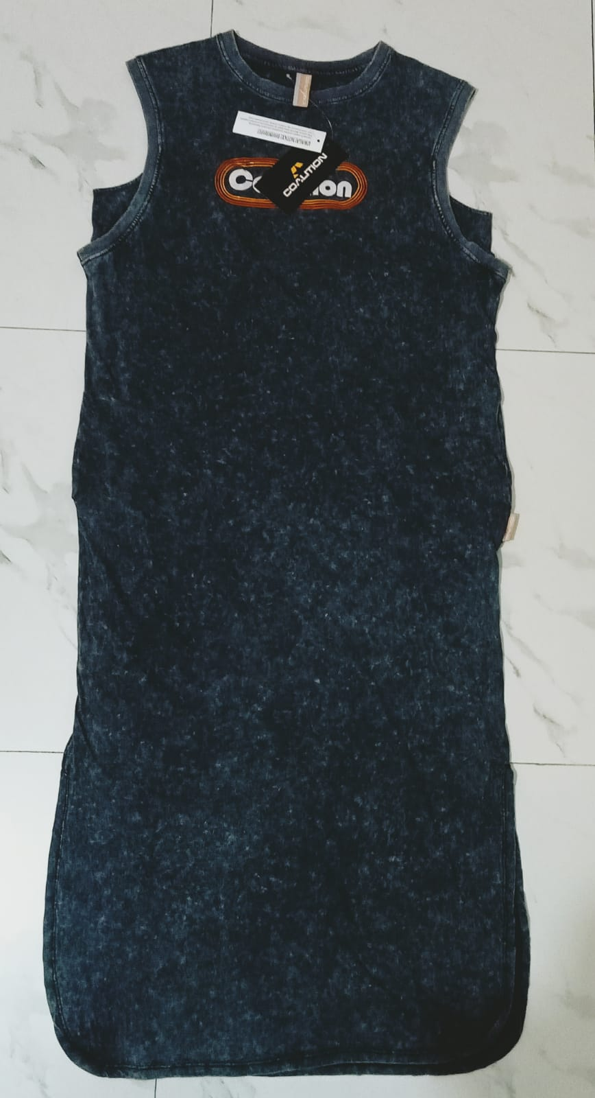
Ladies
Style # CHOCO
Fabric : 100% Cotton 180gsm, acid wash
MOQ – 3000 pcs , Price - $ 4. 97

Slide 5
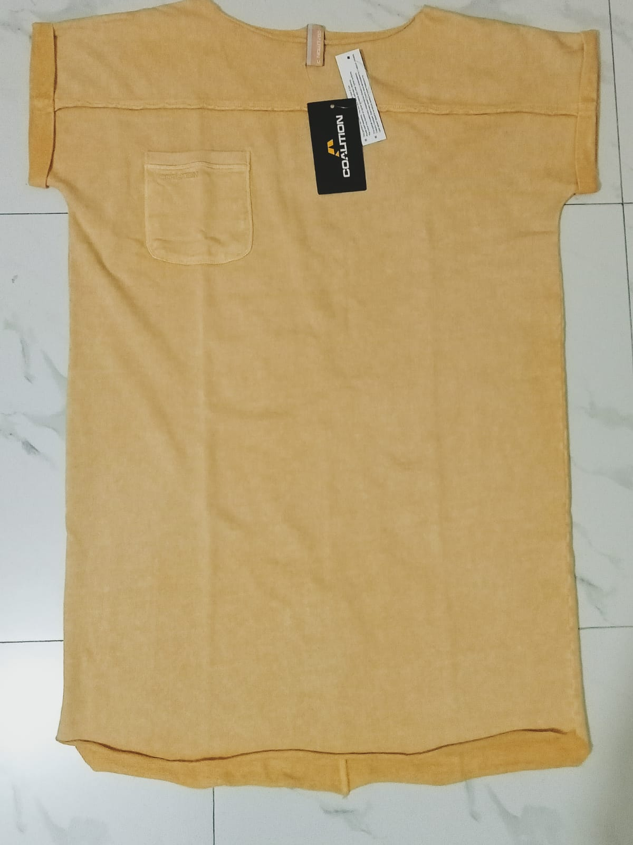
Ladies
Style # UKO
Fabric : 100%cotton French terry, 300gsm, acid wash
MOQ – 3000 pcs , Price - $ 4. 80

Slide 6
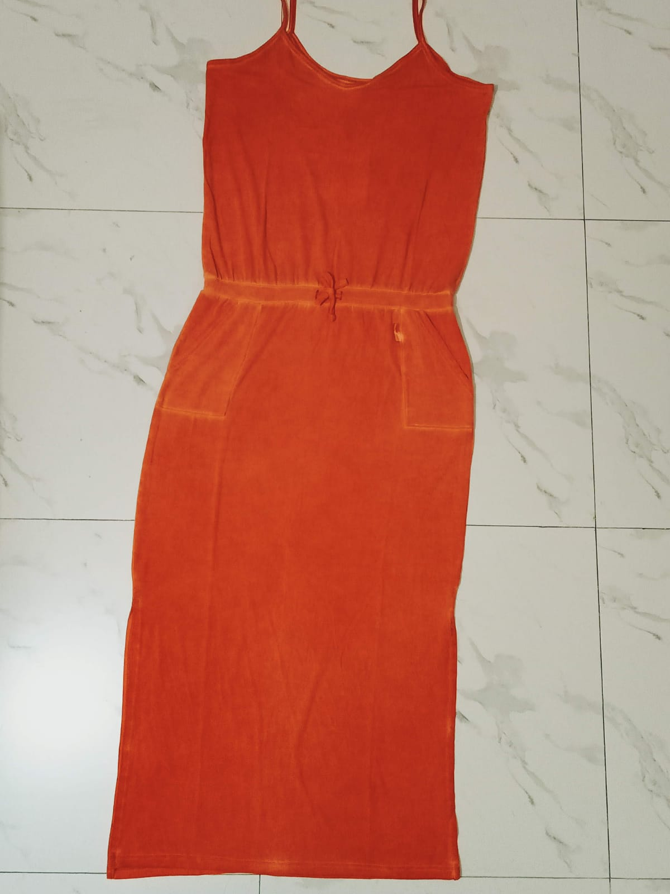
Ladies
Style # LIMDE
Fabric : 57%cotton,38%viscose,5%elastan s. jersey/160gsm,Oil wash
MOQ – 3000 pcs , Price - $ 6. 07

Slide 7
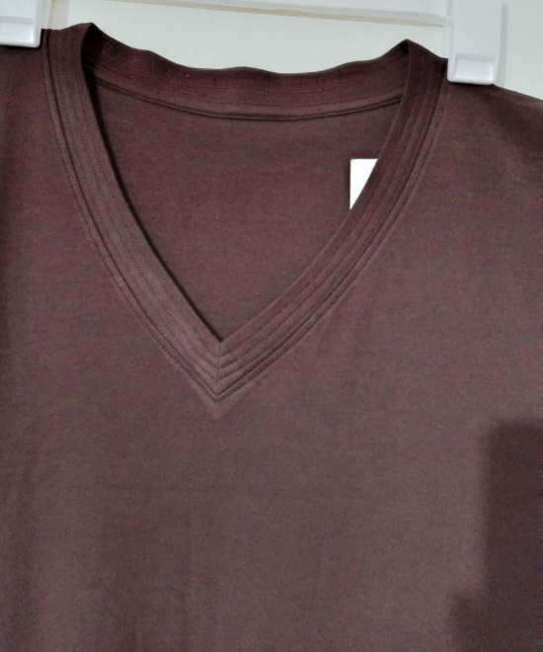
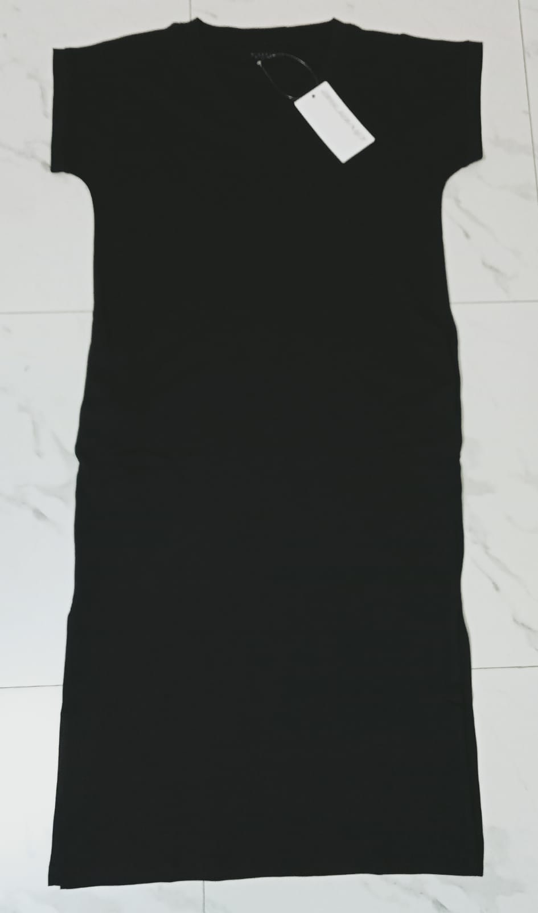
Ladies
Style # IYONA
Fabric : 100% Cotton 220 gsm, interlock, silicone & enzym wash
MOQ – 3000 pcs , Price - $ 4. 65

Slide 8
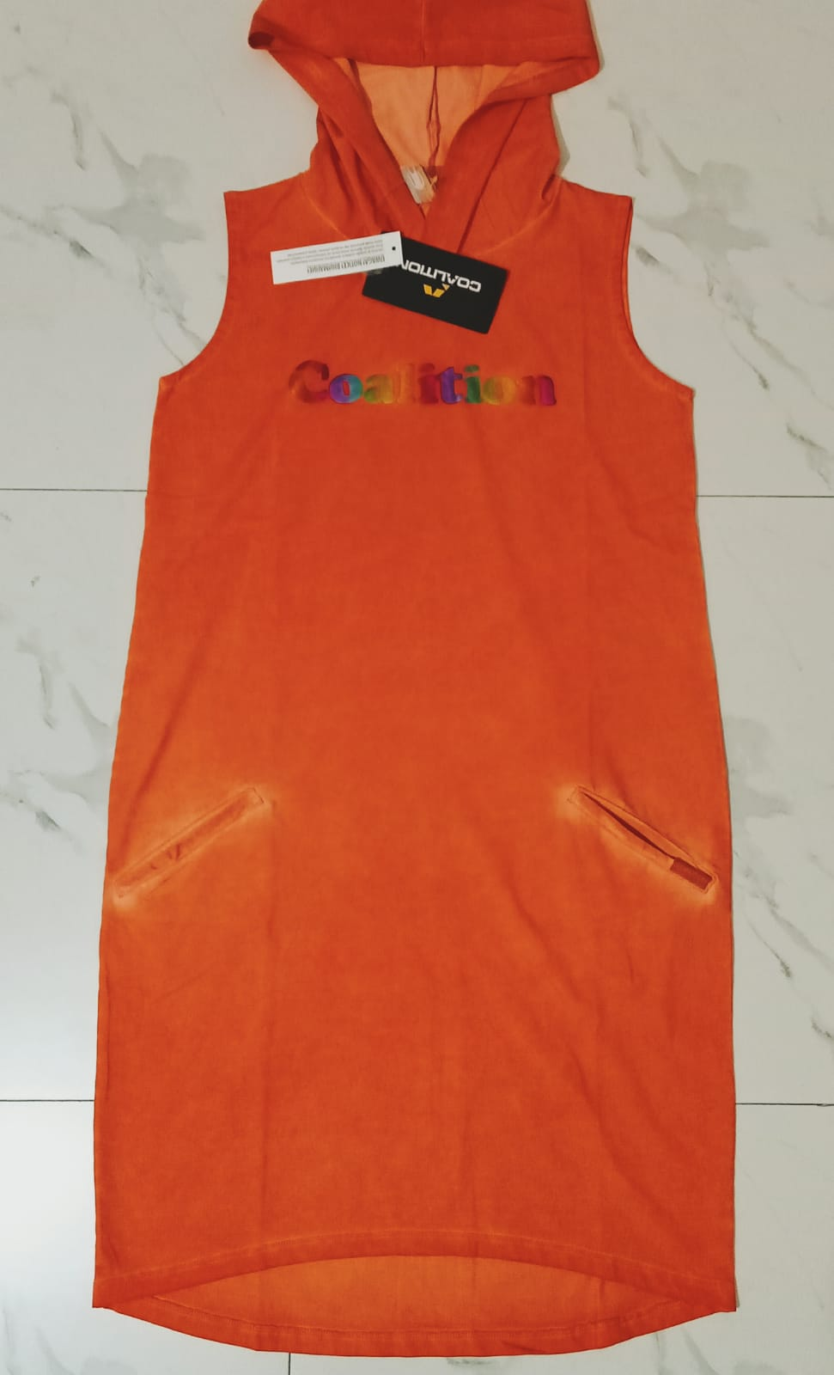
Ladies
Style # ALORA
Fabric : 95% cotton, 5 % elastan single jersey/ 230gsm/acid wash
MOQ – 3000 pcs , Price - $ 5. 85

Slide 9
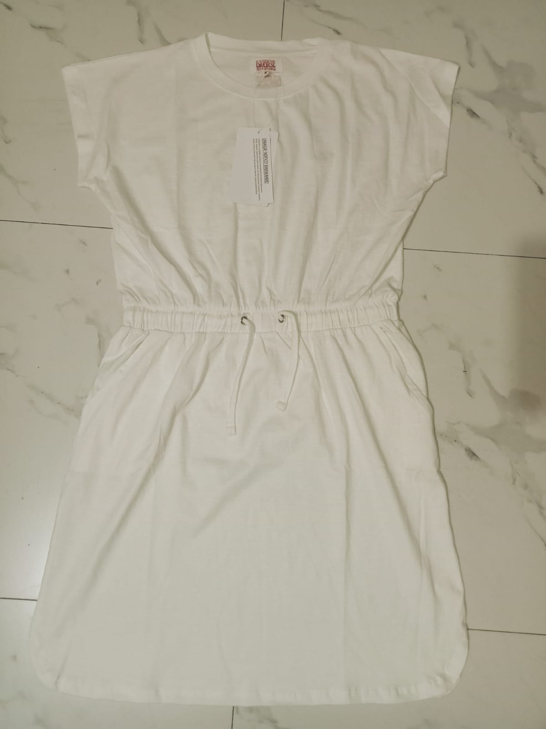
Ladies
Style # SLU
Fabric : 100% COTTON 160gsm/ Slub jersay + garment wash
MOQ – 3000 pcs , Price - $ 3.90

Slide 10
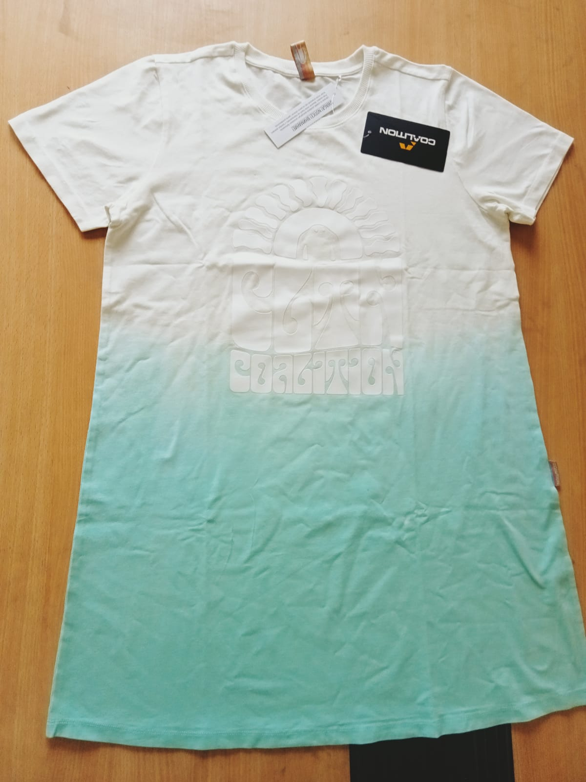
Ladies
Style # WAY
Fabric : 95% Cotton, 5% Elastan 200gsm, Single jersay / DIP DYE EFFECT
MOQ – 3000 pcs , Price - $ 4. 93

Slide 11
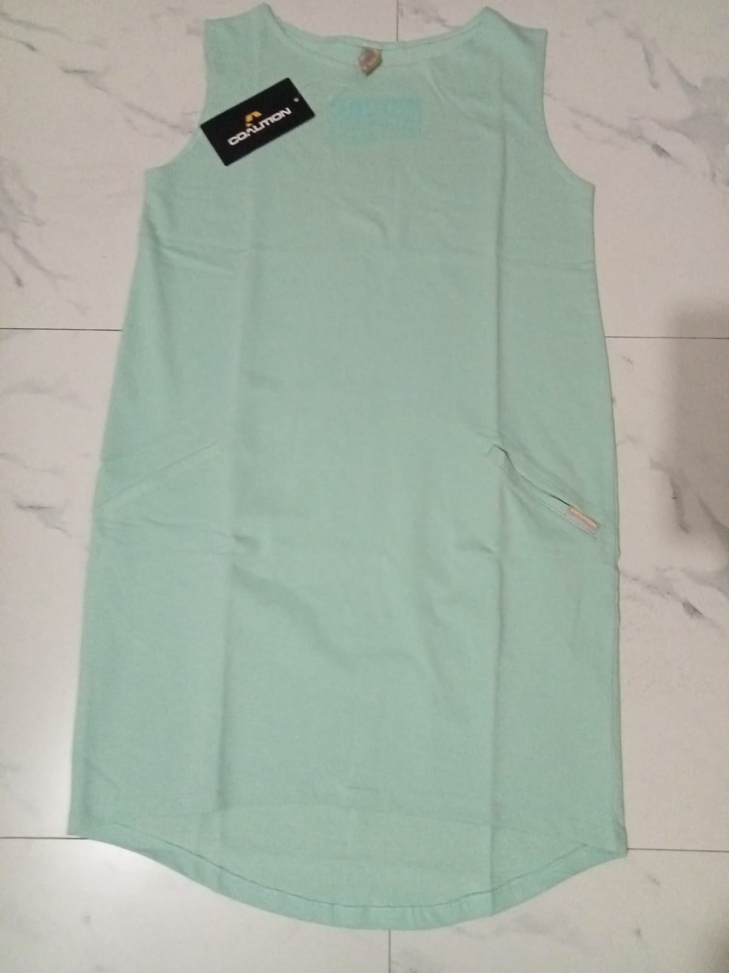
Ladies
Style # MINTE
Fabric : 100% cotton/ silicone enzym wash LOOP TERRY / 250 gsm
MOQ – 3000 pcs , Price - $ 4. 05

Slide 12
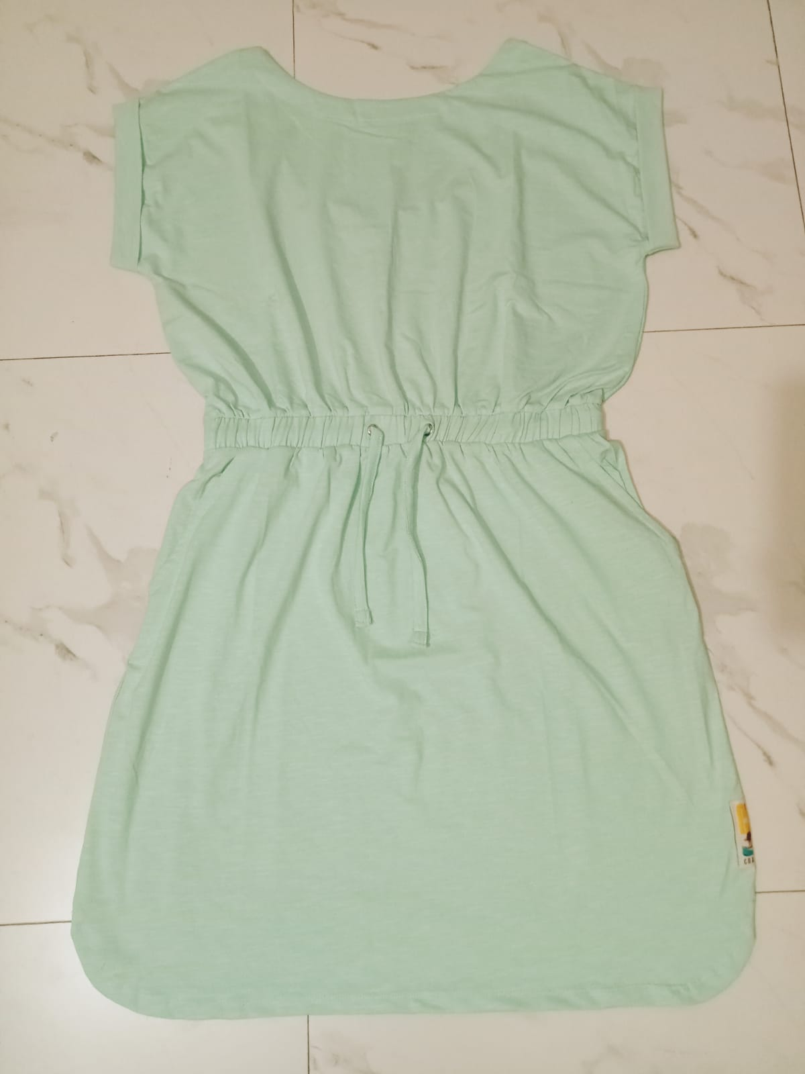
Ladies
Style # OYSKA
Fabric : 95% cotton, 5%elastane SLUB + silicone and enzyme, 180gsm/garment wash
MOQ – 3000 pcs , Price - $ 3. 93

Slide 13
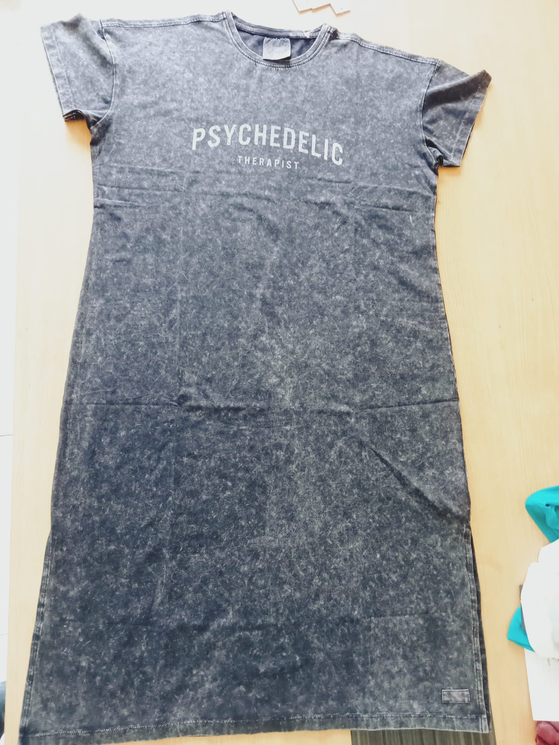
Ladies
Style # KEM
Fabric : 95% cotton, 5 % elastan single jersey- 180 gsm acid wash
MOQ – 3000 pcs , Price - $ 4. 82

Slide 14
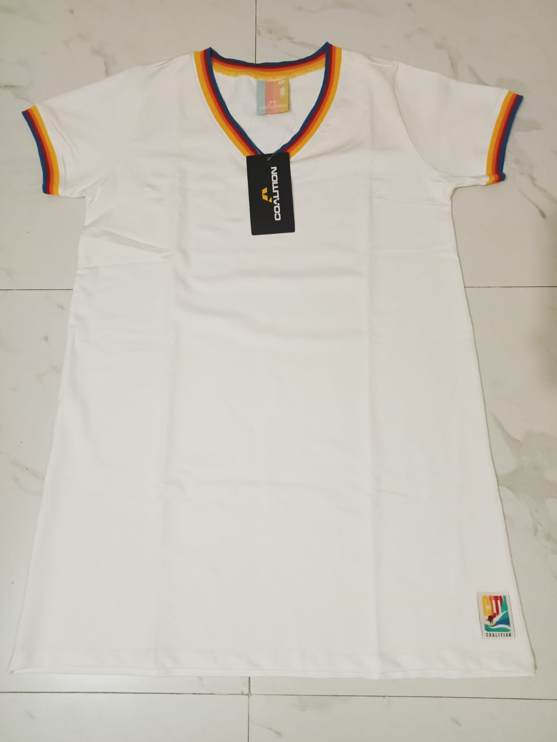
Ladies
Style # VERI
Fabric : 95% Cotton, 5% Elastan 260gsm/ Baby Terry + Light Peach Effect
MOQ – 3000 pcs , Price - $ 4. 23

Slide 15
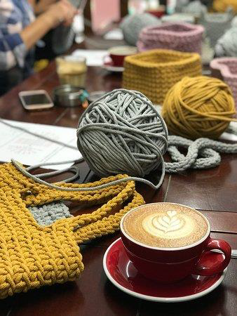
Thank you.

